Slide 1

AZ BOOKINGS
Ashar Zafri
Year 4 Project Engineering 2021/2022
Bachelor of Engineering (Honours) in Software and Electronic Engineering
Galway-Mayo Institute of Technology

Slide 2
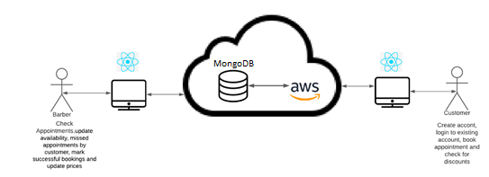
What is AZ Bookings?
AZ Bookings allows customers to choose their barbers and opening slots, based on barber availability. Existing accounts will be able to check personal information (name, email, phone number and gender) Barbers can update availability and mark successful bookings as well as offer discounts.

Slide 3
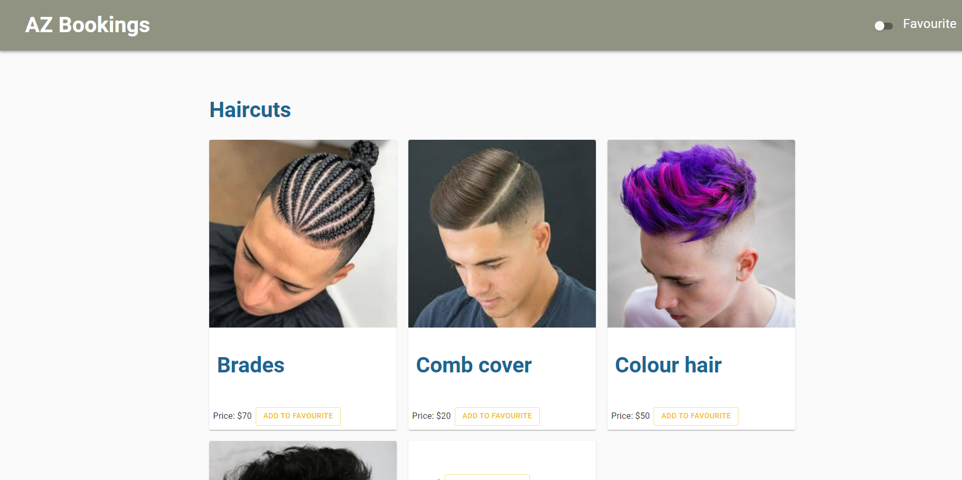

Slide 4




Languages and Technologies
JavaScript
HTML
CSS
Bash

Slide 5
Project Demonstration

Slide 6
Thank you for listening

